Slide 1
New Modular Outdoor Stations VTO4202F-X Series

Slide 2
CHAPTER
ONE
Product Overview

Slide 3
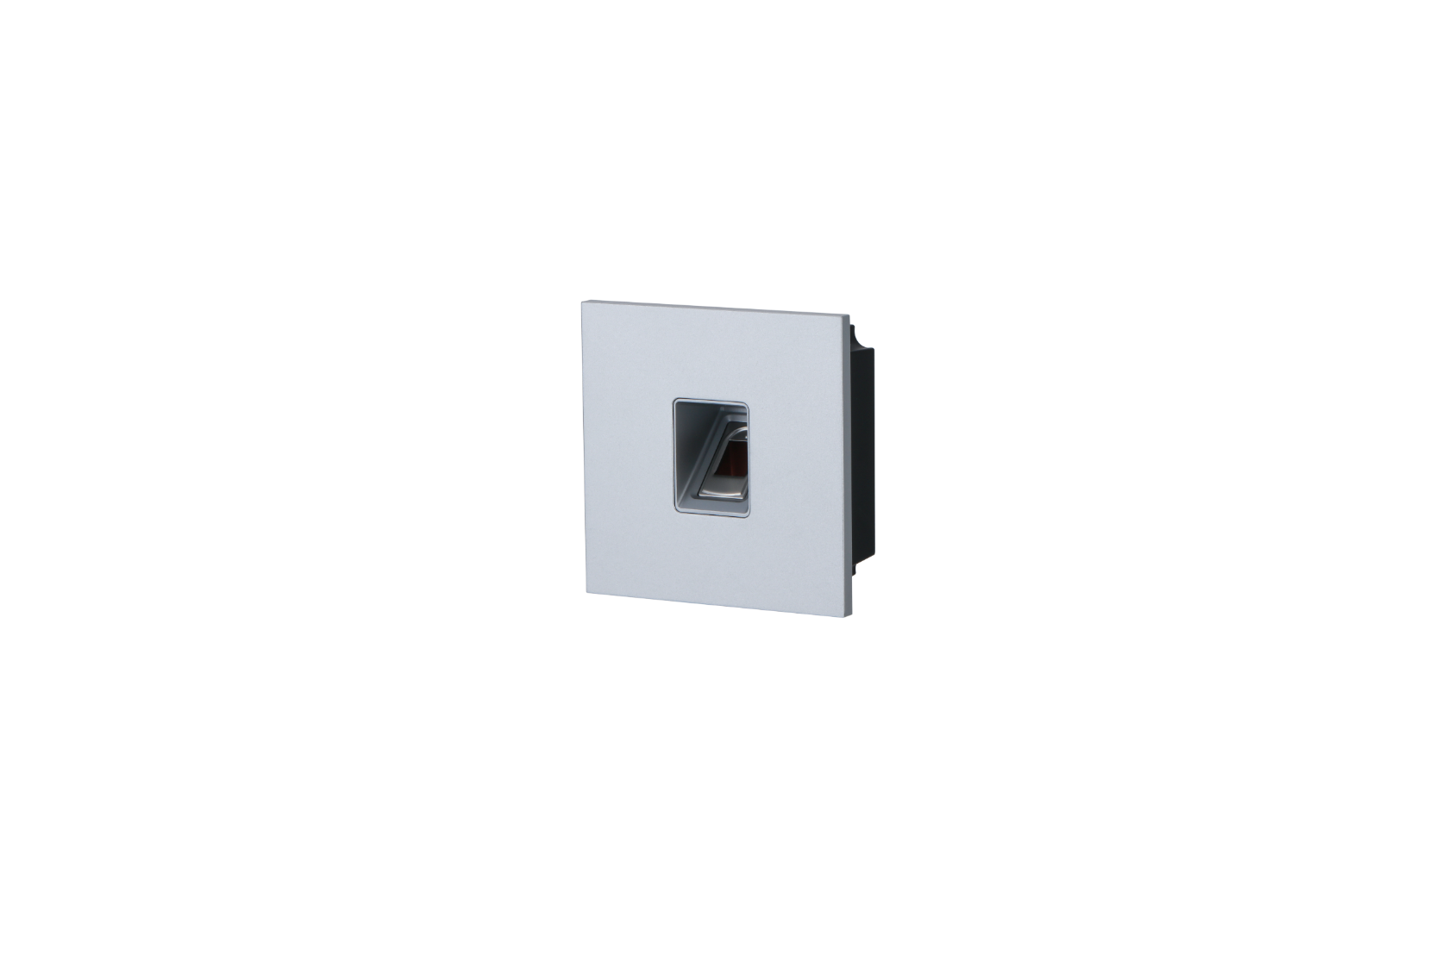
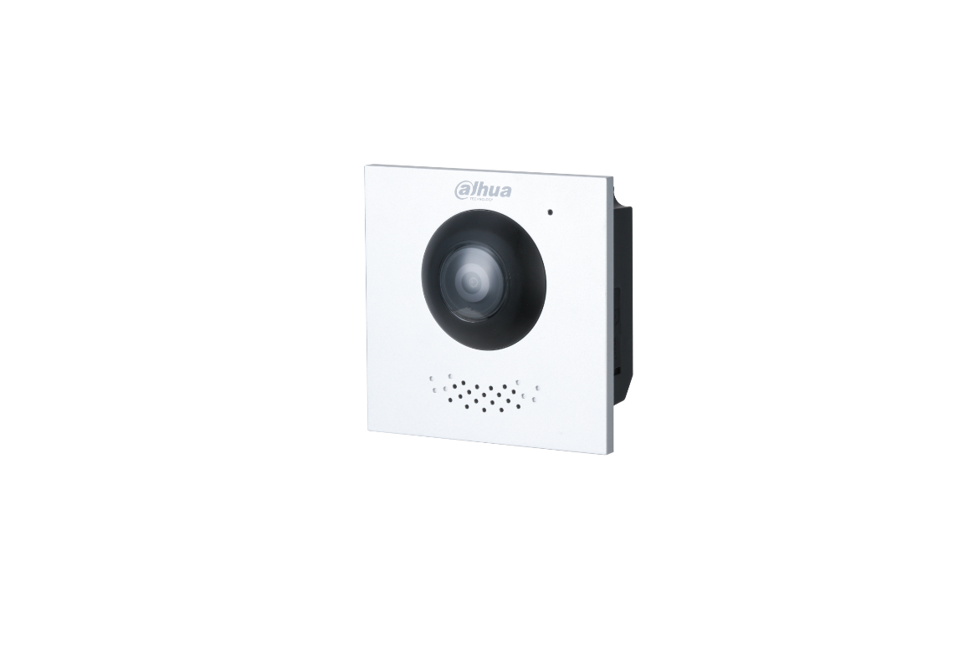
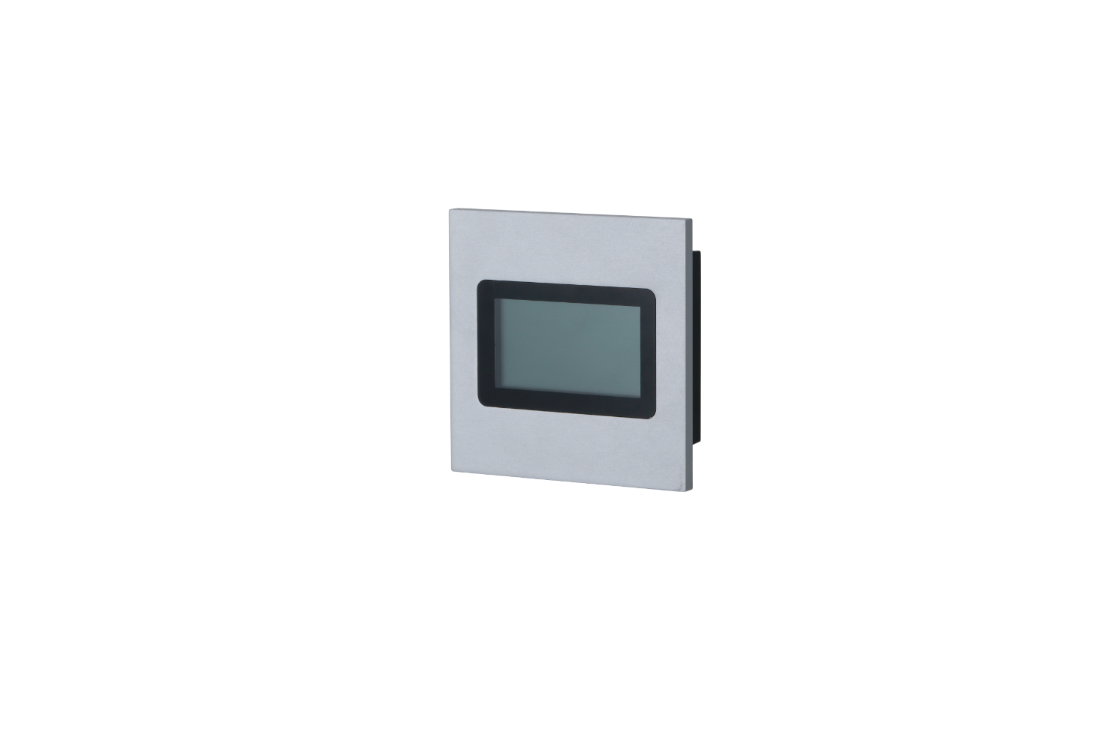
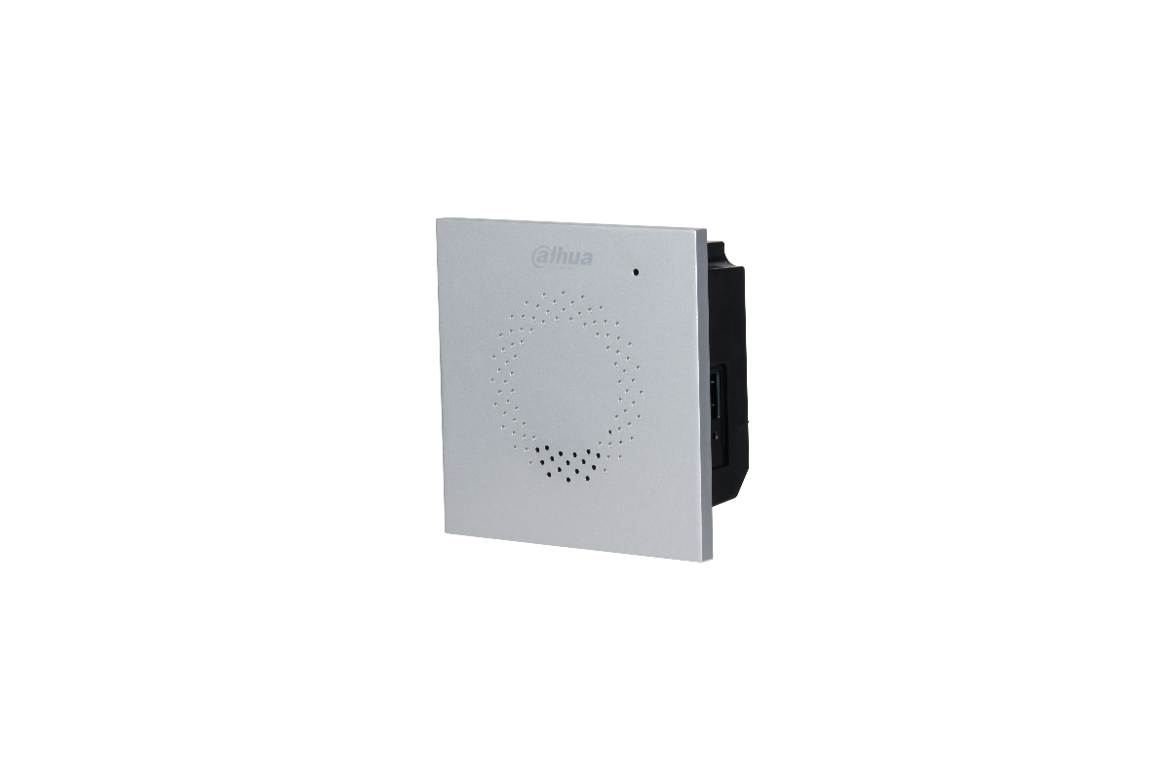
Product overview
Camera module(main)
DHI-VTO4202F-P
Fingerprint module
DHI-VTO4202F-MF
Audio module(main)
DHI-VTO4202F-MA
Display module
DHI-VTO4202F-MS

Slide 4
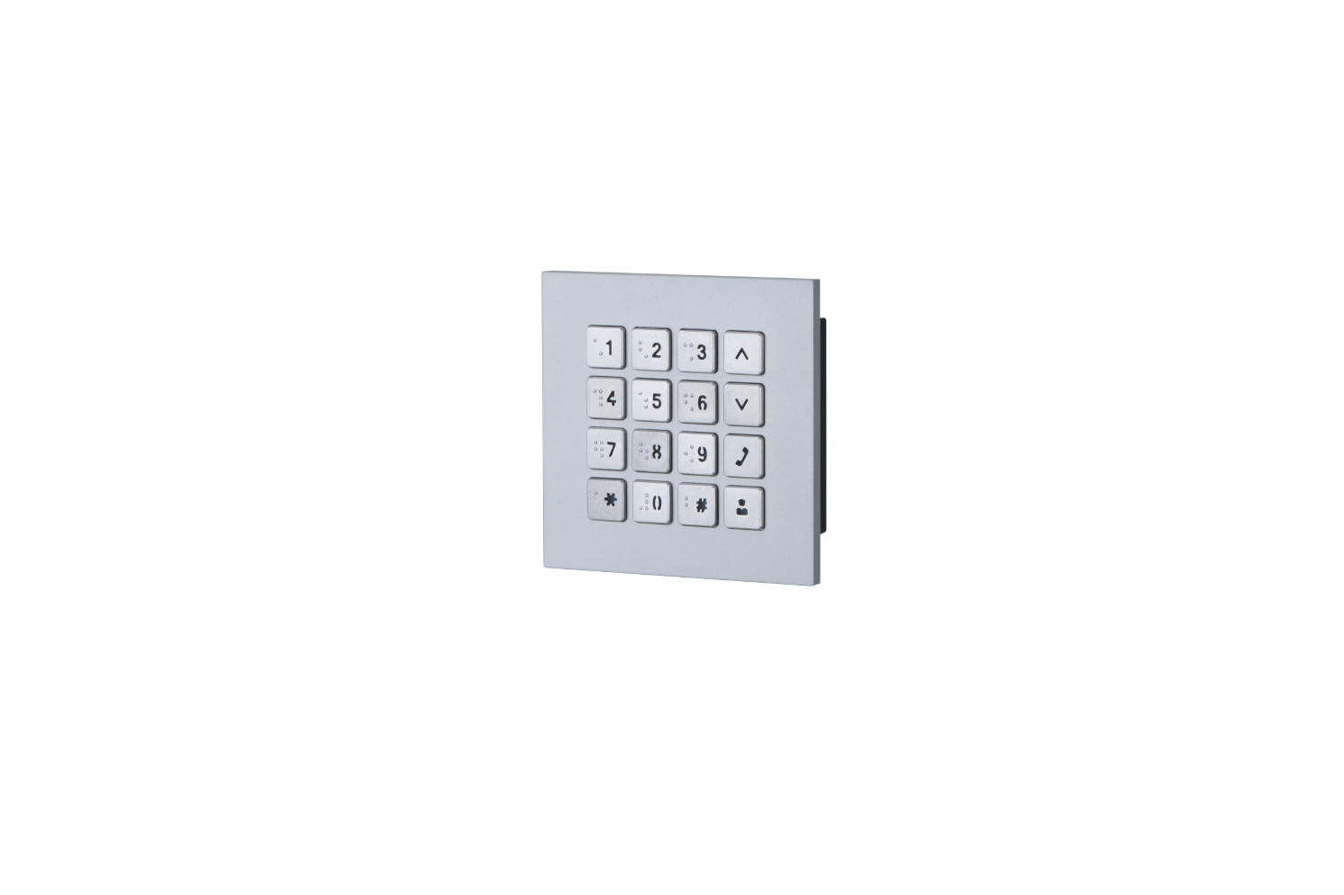
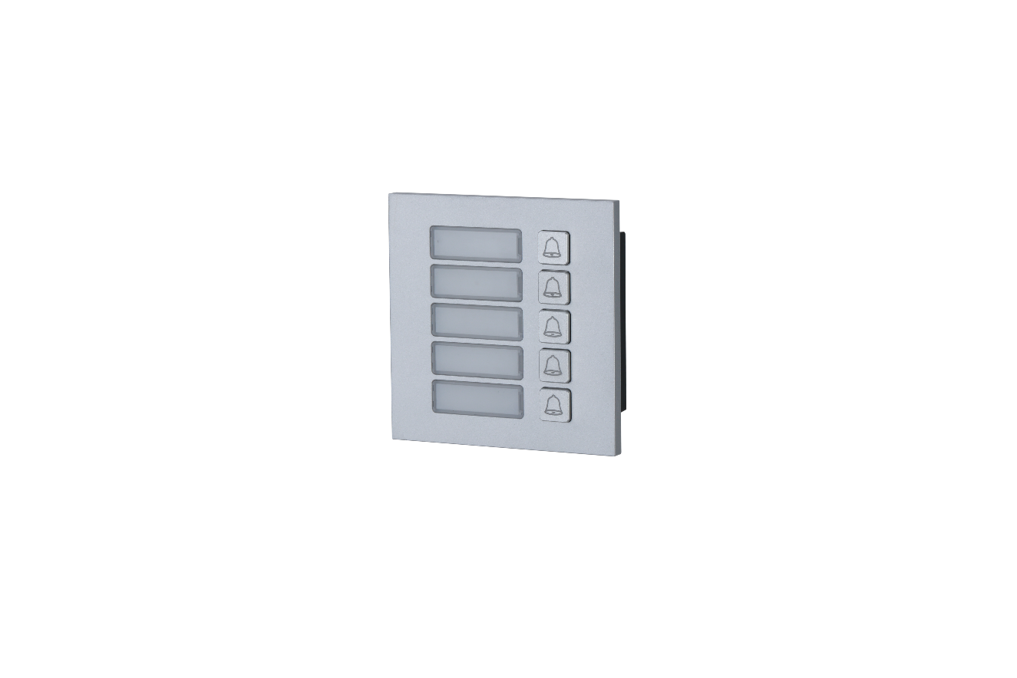
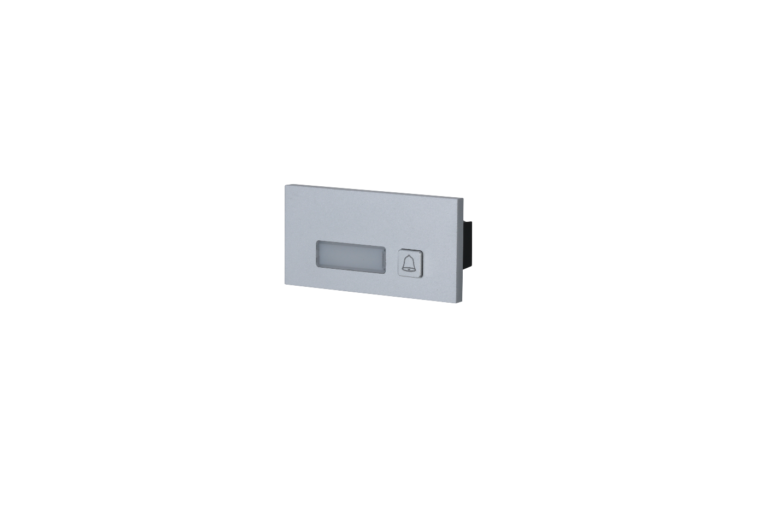
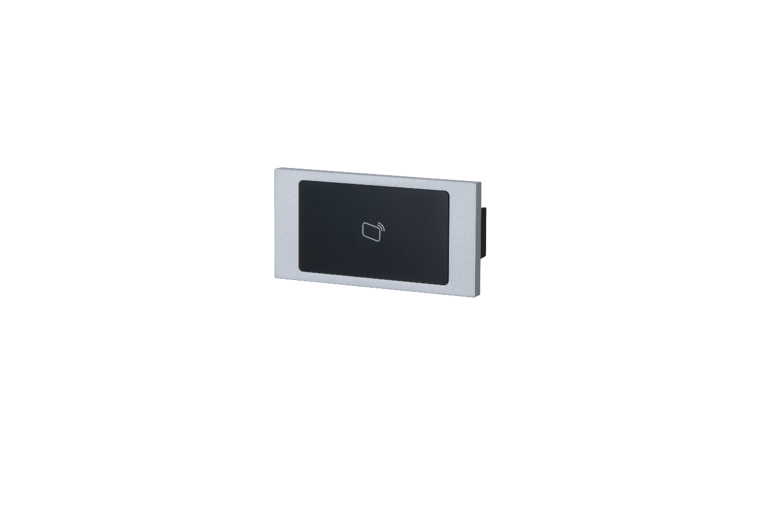
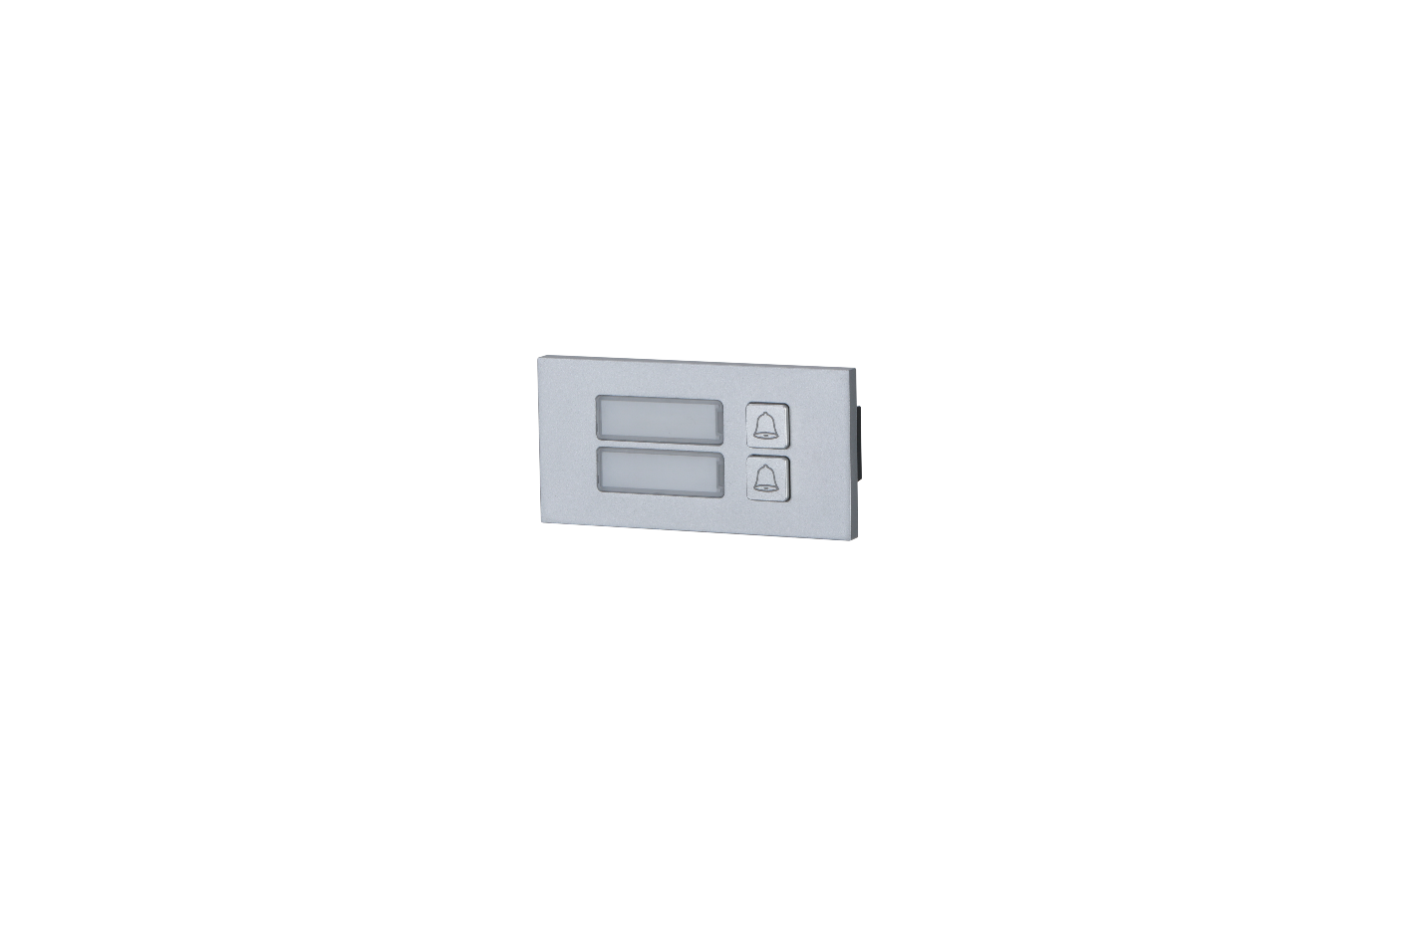
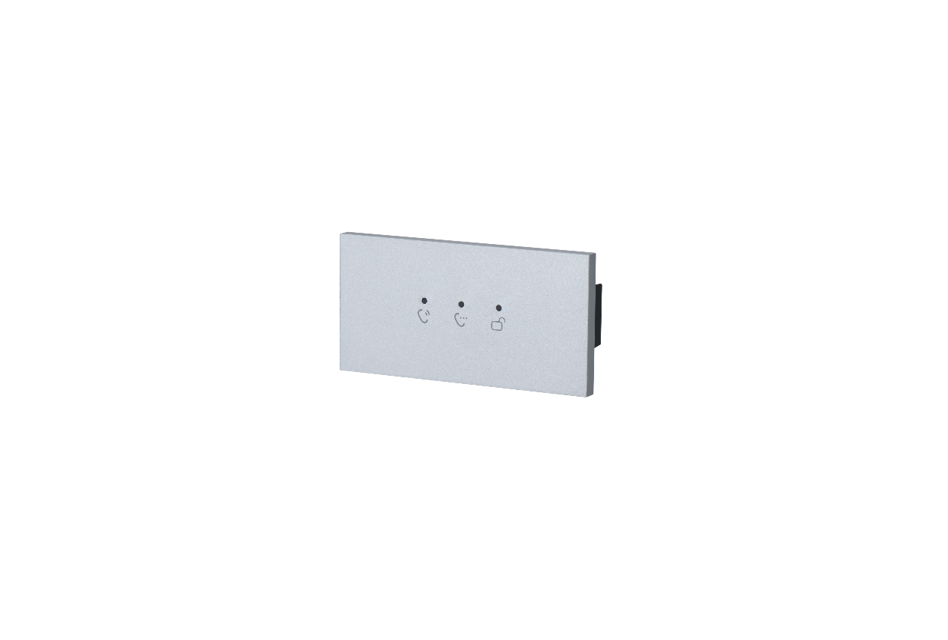
Product overview
5-button module
DHI-VTO4202F-M5
Keyboard module
DHI-VTO4202F-MK
1-button module
DHI-VTO4202F-M1
Card swiping module
DHI-VTO4202F-MR
2-button module
DHI-VTO4202F-M2
Indicator module
DHI-VTO4202F-ML
Blank module
DHI-VTO4202F-MN

Slide 5
Product overview
 | Description | Model | Product Number
1 | Camera module（main） | DHI-VTO4202F-P VTO4202F-P | 1.0.01.15.11254 1.0.01.15.11306
2 | Audio module（main） | DHI-VTO4202F-MA VTO4202F-MA | 1.0.01.15.11282 1.0.01.15.11301
3 | One-button module | DHI-VTO4202F-MB1 VTO4202F-MB1 | 1.0.01.15.11249 1.0.01.15.11307
4 | Two-button module | DHI-VTO4202F-MB2 VTO4202F-MB2 | 1.0.01.15.11250 1.0.01.15.11308
5 | Five-button module | DHI-VTO4202F-MB5 VTO4202F-MB5 | 1.0.01.15.11245 1.0.01.15.11302
6 | Display module | DHI-VTO4202F-MS VTO4202F-MS | 1.0.01.15.11247 1.0.01.15.11304
7 | Indicator module | DHI-VTO4202F-ML VTO4202F-ML | 1.0.01.15.11248 1.0.01.15.11305
8 | Keyboard module | DHI-VTO4202F-MK VTO4202F-MK | 1.0.01.15.11251 1.0.01.15.11309
9 | Fingerprint module | DHI-VTO4202F-MF VTO4202F-MF | 1.0.01.15.11252 1.0.01.15.11310
10 | Card module | DHI-VTO4202F-MR VTO4202F-MR | 1.0.01.15.11246 1.0.01.15.11303
11 | Blank module | DHI-VTO4202F-MN VTO4202F-MN | 1.0.01.15.11279 1.0.01.15.11332

Slide 6
CHAPTER
TWO
Product Features

Slide 7
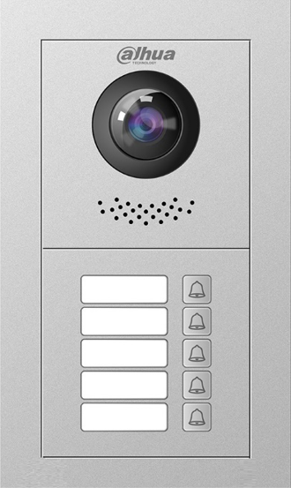
Fisheye camera
See More
Fisheye camera with 160° view range
2 MP high definition
IR light
Horizontal：160°
2-Wire IP
160°

Slide 8
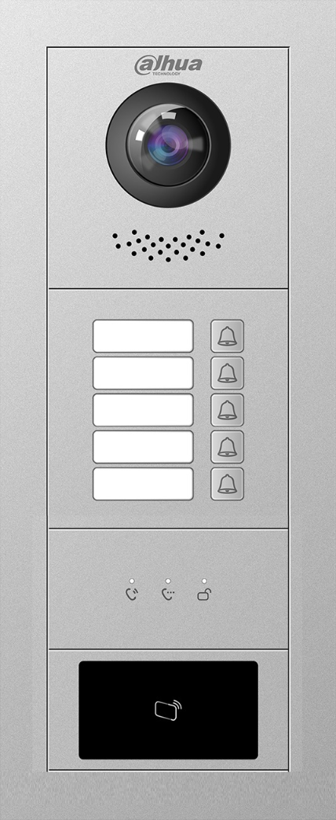
Surface and Flush Installation
IP65
IK07
-20℃~+60℃
Easy installation with mounted box. With high protection degree IP65 and IK07, it can work normally under different environments and scenarios.

Slide 9
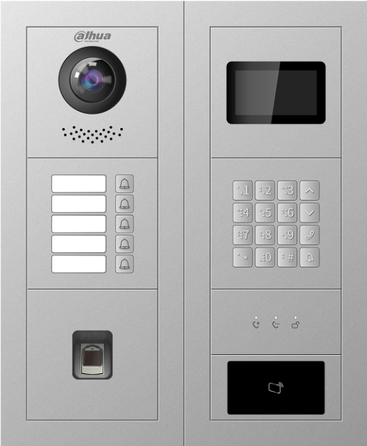
Flexible combination
Meet more diverse needs
Display module
Two-module or Three-module mounting
Semi-module design
Nine modules can be selected, apart from main modules.
Indicator module
Card swiping module
Fingerprint module

Slide 10
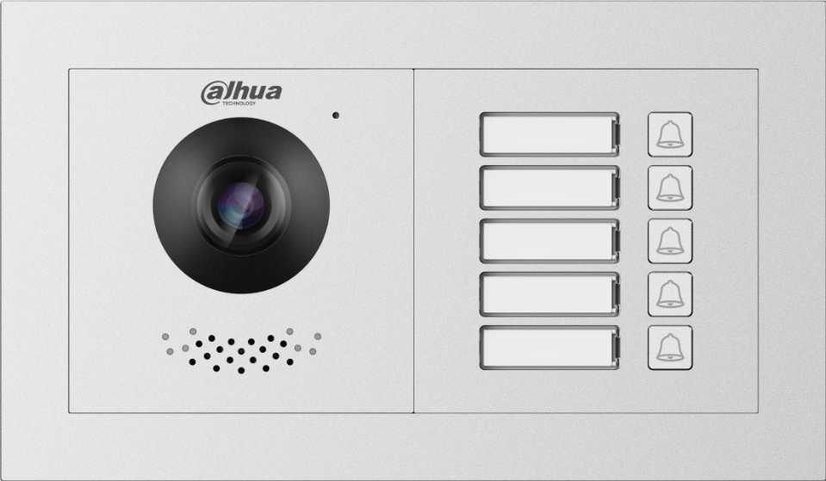
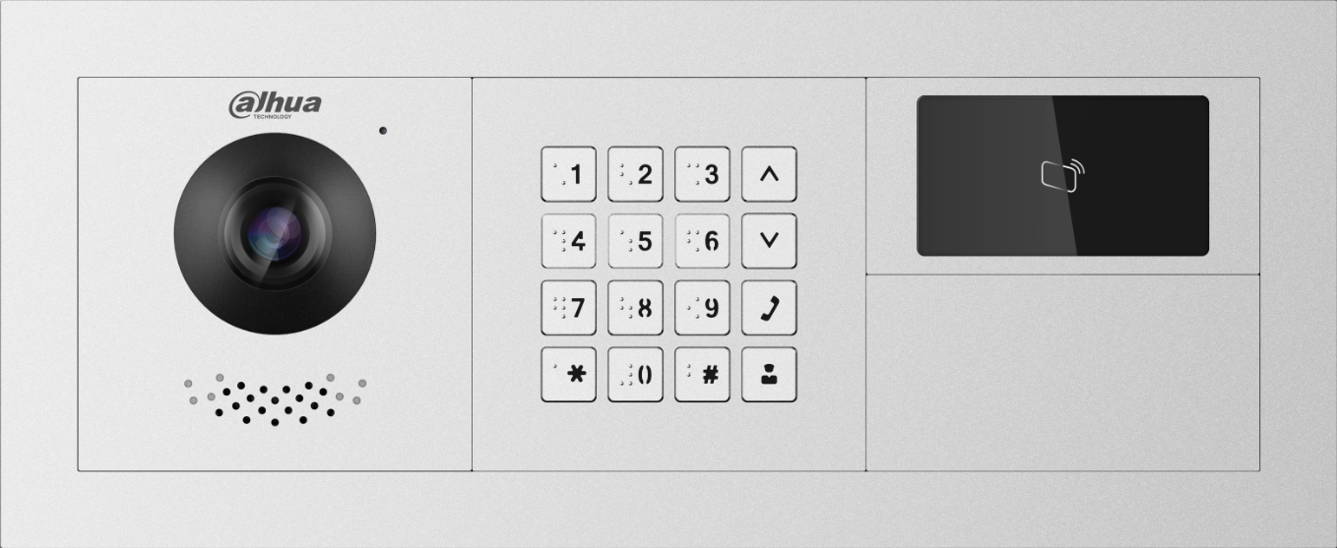
Horizontal installation
Meet more diverse needs
5-button module
Two modules and three modules can be installed horizontally or vertically.
Different installation methods can be applied to more different scenarios.
Blank module
Keyboard
module
with Braille

Slide 11
Comparison
VTO4202F-X Series
VTO2000A-X Series
Processor
High-performance processor.
Processor
Old processor.
Camera
CMOS Low Illumination 2MP HD Colorful 160° Fisheye Camera
Camera
CMOS 1.3MP HD Camera
Protection Grade
IP65/IK07
Protection Grade
IP54/IK07

Slide 12
…
Comparison
VTO4202F-X Series
VTO2000A-X Series
Display
3.0 inch STN display
Combined with Keyboard module
Display
Nonsupport
Indicator
Calling/Communicate/Unlocked
Indicator
Nonsupport
Semi-module design
Card swiping module
Indicator module
One/Two-button module
Blank module
…
…

Slide 13
延迟符
CHAPTER
THREE
Typical Application

Slide 14
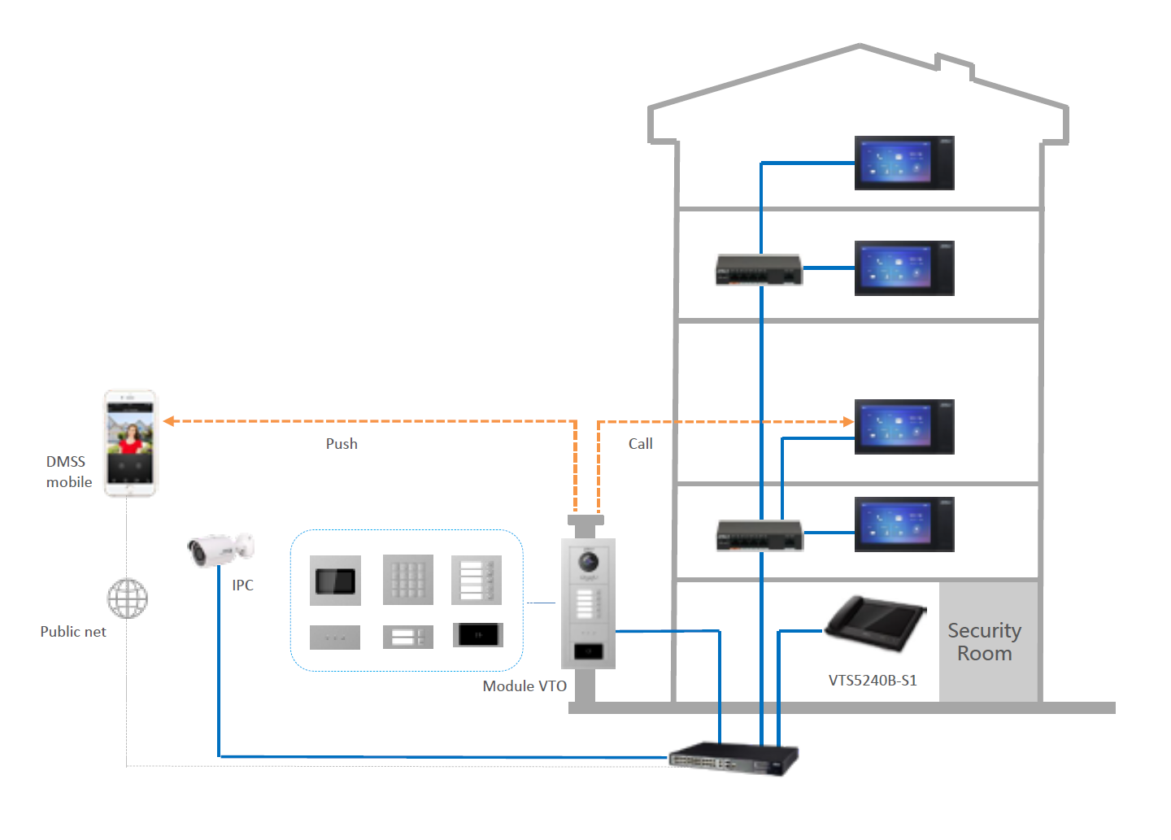
Application, for SIP Apartment Solution

Slide 15
Thank you!

